Slide 1
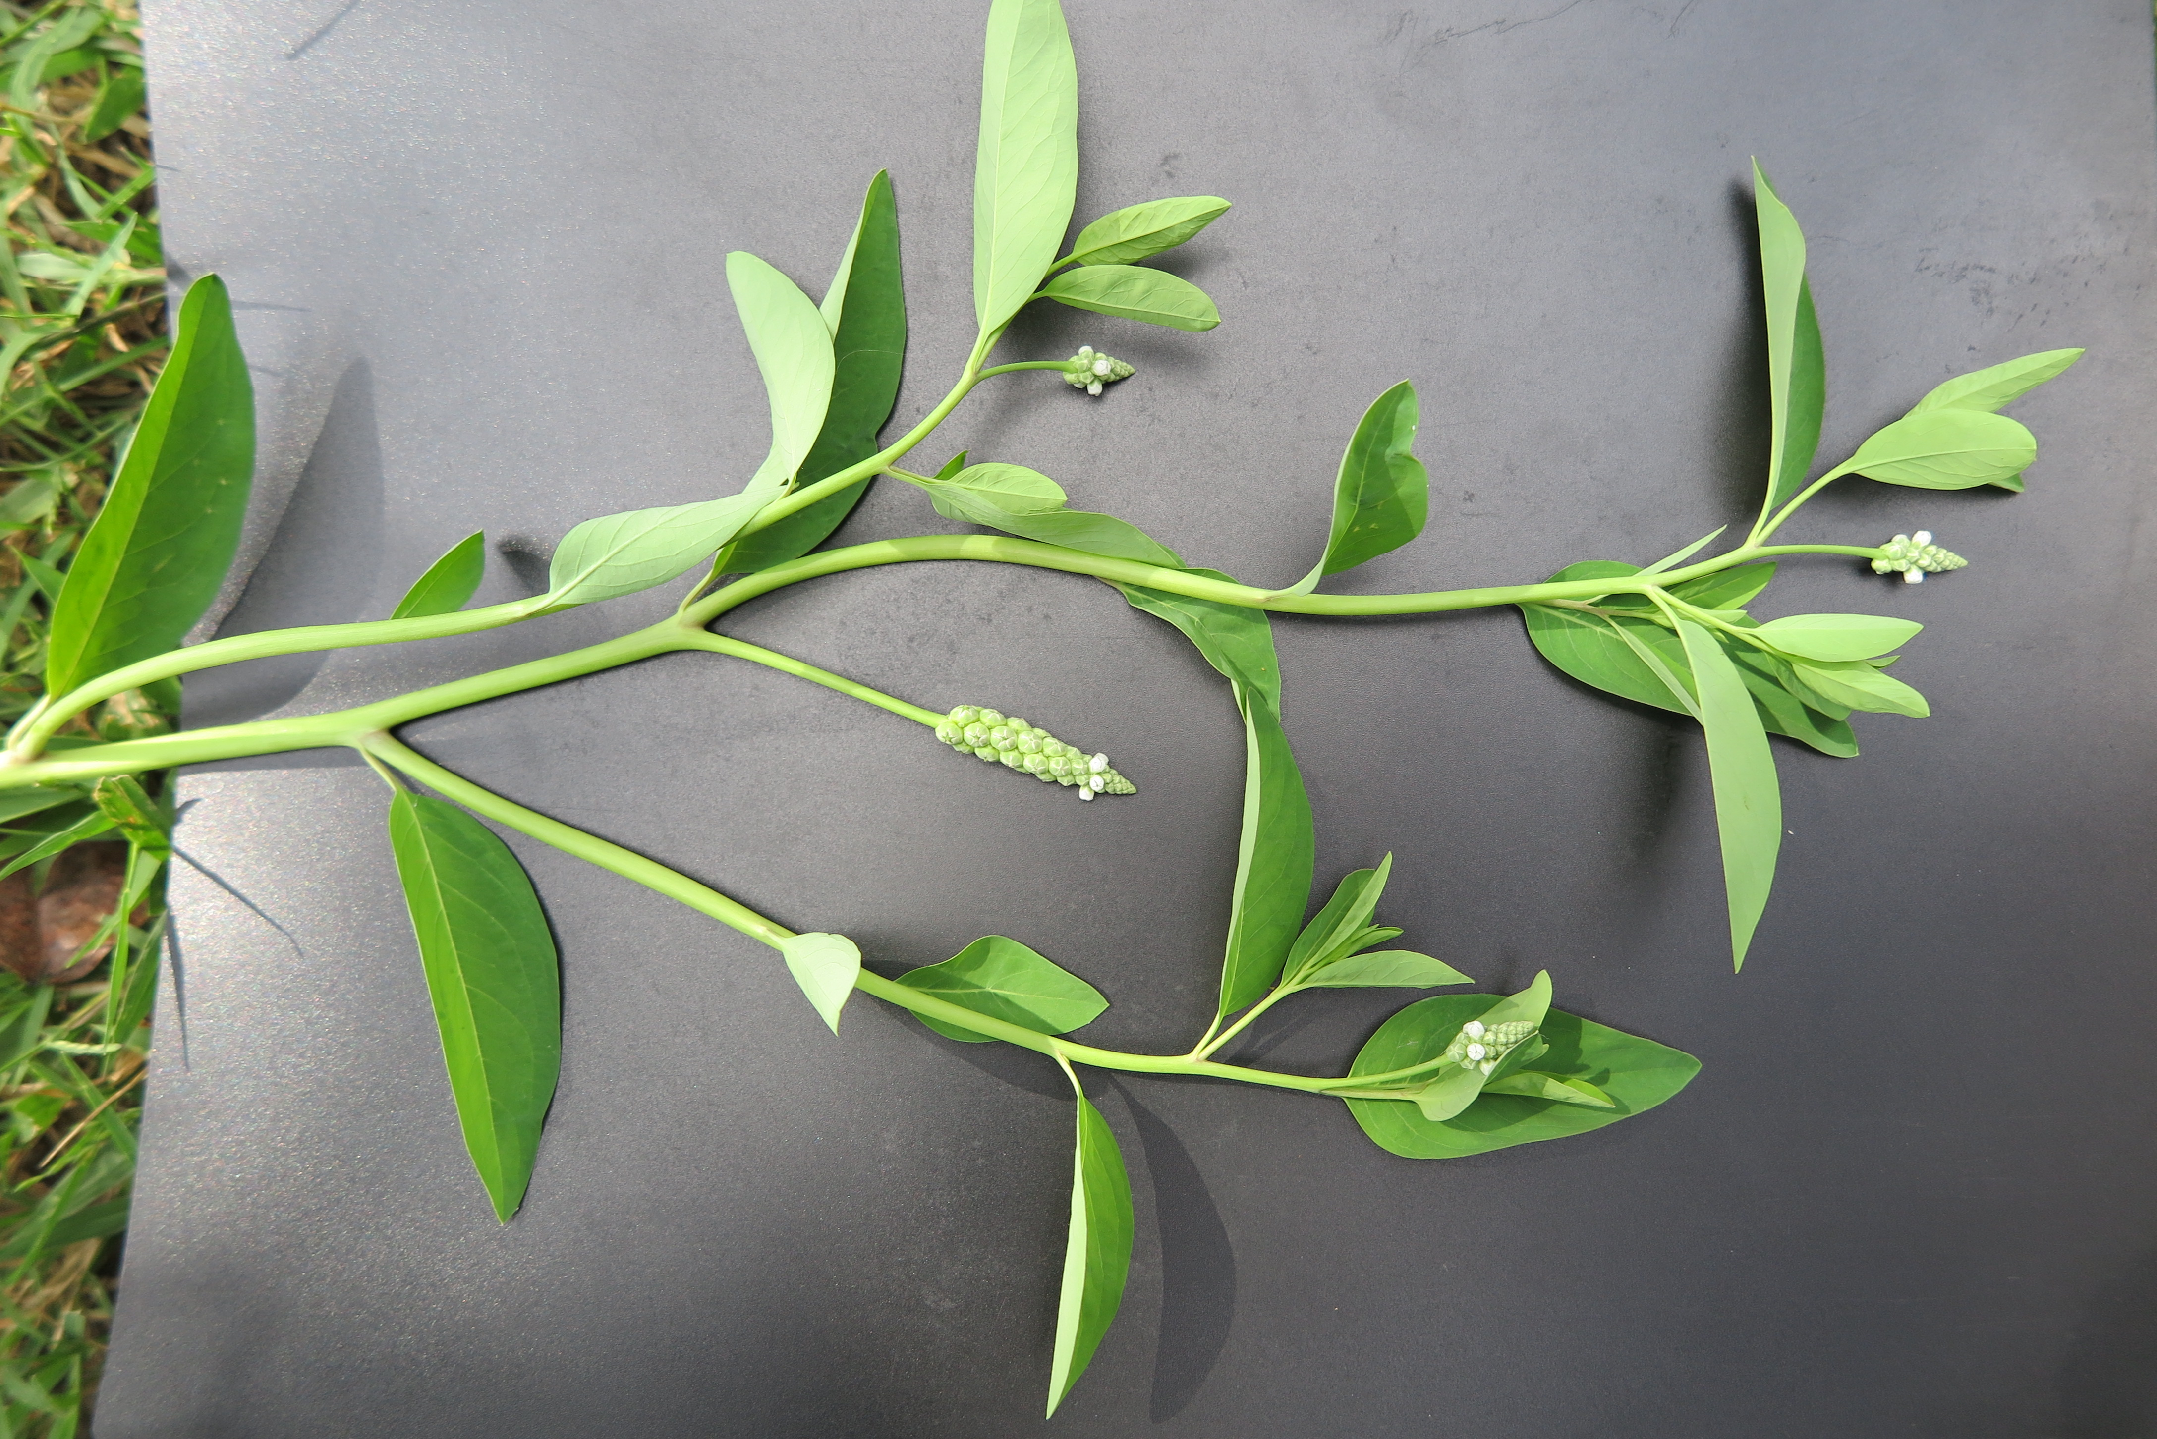
Sphenochlea zealanica

